Slide 1
Cataloging as civic engagement
Providing inclusive local subject alternatives to offensive headings

Slide 2
Miami University Land Acknowledgement
Miami University is located within the traditional homelands of the Myaamia and Shawnee people, who along with other indigenous groups ceded these lands to the United States in the first Treaty of Greenville in 1795. The Miami people, whose name our university carries, were forcibly removed from these homelands in 1846.
In 1972, a relationship between Miami University and the Miami Tribe of Oklahoma began and evolved into a reciprocal partnership, including the creation of the Myaamia Center at Miami University in 2001. The work of the Myaamia Center serves the Miami Tribe community and is dedicated to the revitalization of Miami language and culture and to restoring that knowledge to the Myaamia people.
Miami University and the Miami Tribe are proud of this work and of the more than 140 Myaamia students who have attended Miami since 1991 through the Myaamia Heritage Award Program.

Slide 3
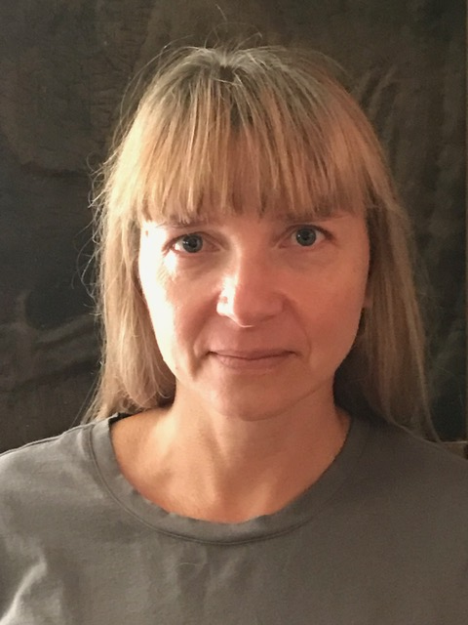
Masha Stepanova Coordinator of Cataloging & Slavic Librarian Miami University stepanm@miamioh.edu

Slide 4
Motivation for inclusive cataloging project at Miami
Report of the SAC Working Group on Alternatives to LCSH "Illegal aliens”
http://hdl.handle.net/11213/14582
OhioLINK DIAD guidelines for dealing with outdated and offensive terms
https://www.ohiolink.edu/sites/default/files/uploads/Guidelines_for_Outdated_Terms_FINAL.pdf

Slide 5
Preparations
Theoretical
Which alternative headings do we use?
How far do we take this?
Practical procedure
Developing the workflow

Slide 6
Things to consider before starting
Maintenance and regular updates after the initial project (frequency, procedure)
How much automation is possible ?
Replace headings or add?
Authority control: do we add local authority records?
How many aliens are extraterrestrial?

Slide 7
Workflow
Procedure, screenshots, and the table of alternative subjects

Slide 8
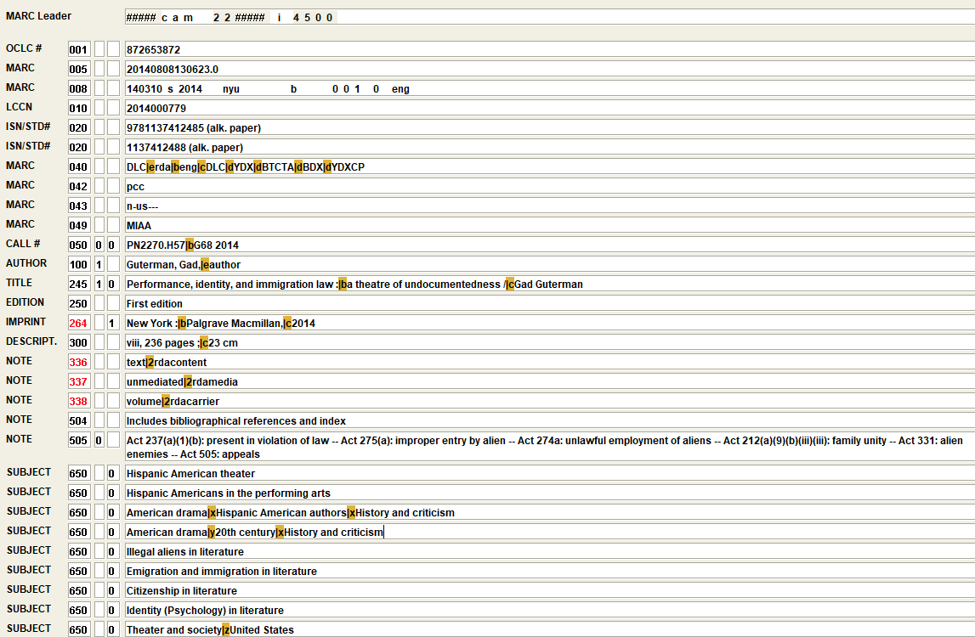
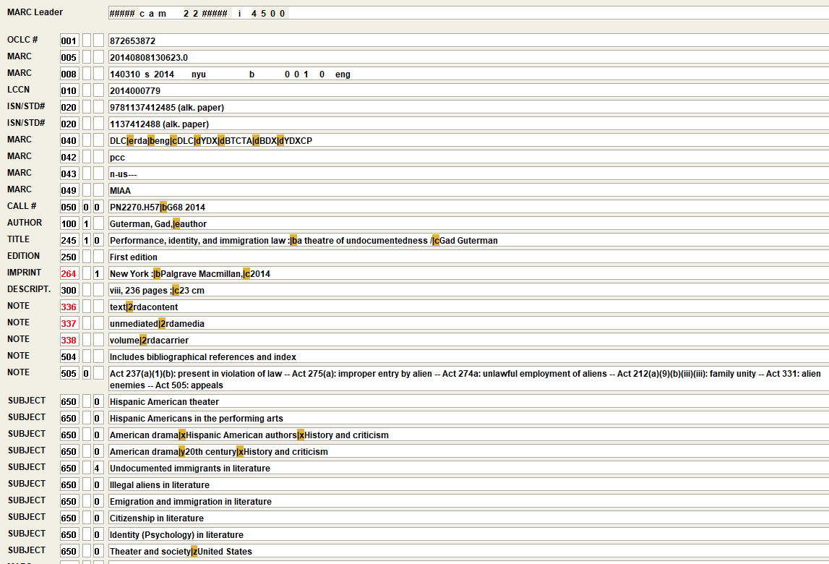
Record examples with and without the local heading

Slide 11
Next steps and future plans
Outreach to campus populations
Myaamia Center
Center for Diversity and Inclusion
Race, gender, sexuality headings

Slide 12
Thank you!

